Slide 1
Database Design and Development
Topic 12:
Module Overview
Notes:
NCC Education - Title Master

Slide 2
Scope and Coverage
This topic will cover:
  Module overview
Notes:
NCC Education - Slide Master

Slide 3
Learning Outcomes
By the end of this topic, students will be able to:
  Summarise the key module topics
  Give an outline of the knowledge needed about each topic for assessment purposes

Slide 4
Overview of Module
Topic 1 | Introduction to the Module Key concepts in databases and database development
Topic 2 | Enhancing Design 1
Topic 3 | Enhancing Design 2
Topic 4 | Data Retrieval 1
Topic 5 | Data Retrieval 2
Topic 6 | Physical Design 1
Topic 7 | Physical Design 2
Topic 8 | Physical Design 3
Topic 9 | Physical Design 4
Topic 10 | Distributed Databases
Topic 11 | Data Warehouses
Topic 12 | Summary

Slide 5
Database System in Detail
DBMS serves as intermediary
between user and the database by translating
user requests into the complex code required
to fulfill those requests
User
Customer
Processing
Application
DATA
Application Requests
Data
METADATA
User
Rental
Processing
Application
Application Requests
Data
Application Requests
DBMS
User
Other
Application
Database
Management
System
Database
Data
Application programs might be written in a programming
Language, such as Visual Basic or C++, or it might
be created through a DBMS utility e.g. Access’s forms wizard.
Notes:
Picture by Gary Budgen based on one in Kroenke book

Slide 6
Common Types of Database Systems
  Transaction Processing Systems
  Management Information Systems
  Data Warehouses
  Distributed Databases

Slide 7
Activity: Metadata
  What is metadata?
  What are data-types?
  Define metadata for an entity in:
    Student record system
    Car hire system
    Holiday booking system

Slide 8
Key Concepts of Relational Model
  Relations and tables
  Attribute
  Domain
  Tuples and rows
  Primary Key
  Foreign Key

Slide 9
Phases of Database Design
  Conceptual database design
  Logical database design
  Physical database design

Slide 10
Database Design and Our Topics
Topic 1 | Introduction to the Module Key concepts in databases and database development
Topic 2 | Enhancing Design 1 CONCEPTUAL AND LOGICAL
Topic 3 | Enhancing Design 2 CONCEPUTAL AND LOGICAL
Topic 4 | Data Retrieval 1
Topic 5 | Data Retrieval 2
Topic 6 | Physical Design 1 PHYSICAL
Topic 7 | Physical Design 2 PHYSICAL
Topic 8 | Physical Design 3 PHYSICAL
Topic 9 | Physical Design 4 PHYSICAL
Topic 10 | Distributed Databases
Topic 11 | Data Warehouses
Topic 12 | Summary

Slide 11
Properties of a Relation
  Relation Named
  Atomic values in cells
  Attribute Named
  Attribute value drawn from a domain
  No duplicate tuples (rows)
  No significance to order of tuples
  No significance to order of attributes

Slide 12
Functional Dependence
  A → B
  This is the notation
  If we know the value of A then we will know the value of B

Slide 13
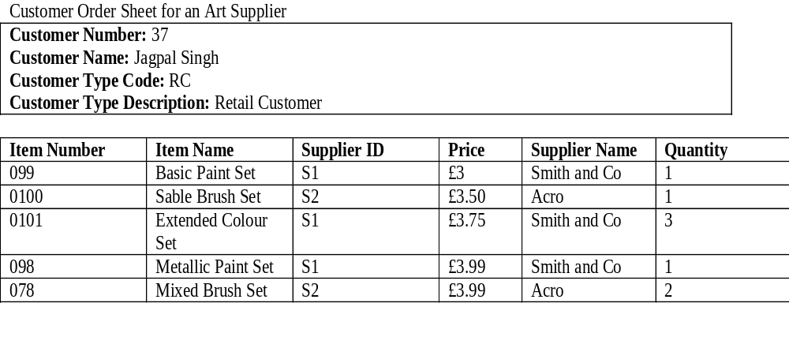
Customer Order Sheet for Art Supply Shop

Slide 14
Logical Design
  Step One: Create and check ER model
  Step Two: Map ER Model to tables

Slide 15
Logical Design Step One - 1
  Step One: Create and check ER mode
  1.1 Identify entities
  1.2 Identify relationships
  1.3 Identify and associate attributes with entities
  1.4 Determine attribute domains
  1.5 Determine candidate, primary and alternative key attributes

Slide 16
Logical Design Step One - 2
  Step One: Create and check ER mode
  1.6 Specialise/Generalise entities (optional step, not covered here)
  1.7 Check model for redundancy
  1.8 Check model supports user transactions
  1.9 Review model with user

Slide 17
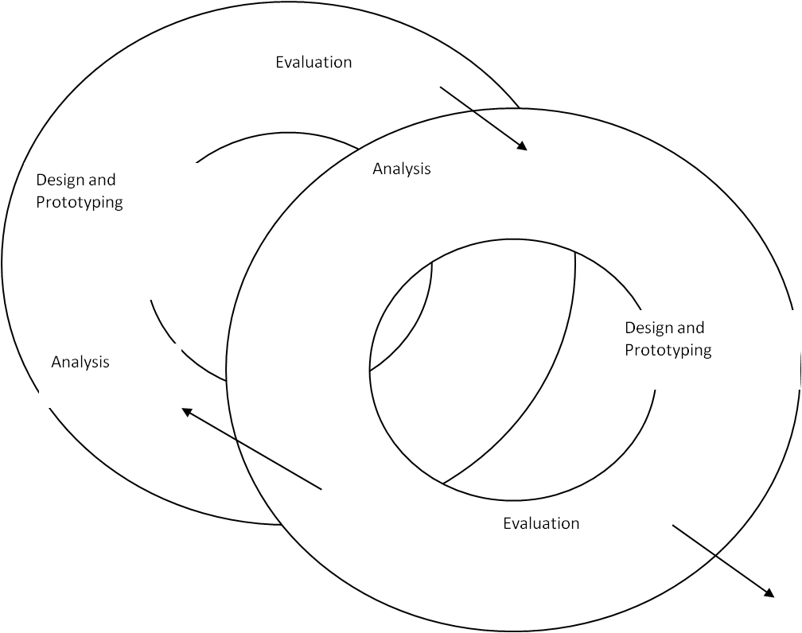
Step 1.9 Review Model with User

Slide 18
Objectives of SQL
  Create the database and relation structures
  Perform basic tasks such as inserts, updates and deletes
  Simple and complex queries
Structured Query Language

Slide 19
Data Definition Language DDL
  For defining database structures and controlling access to data
    CREATE TABLE, CREATE INDEX , CREATE SEQUENCE , GRANT ACCESS etc.
  Data Manipulation Language DML
    For retrieving and updating data
      SELECT, INSERT, UPDATE, DELETE

Slide 20
Data Manipulation Language DML
  For retrieving and updating data
  SELECT
  INSERT
  UPDATE
  DELETE

Slide 21
The Join Operation
  Used to retrieve data from more than one table
  Simple join
  Multi-table join
  Outer-join

Slide 22
Step 3
  3.1 Design Base Tables (covered in this lecture)
  3.2 Design representations of derived data (covered in Unit 7)
  3.3 Design remaining business rules (covered in Unit (Unit 8)

Slide 23
Step 4
  4.1 Analyse transactions (covered in Unit 9)
  4.2 Choose file organisations (covered in Unit 9)
  4.3 Choose indexes (covered in Unit 9)

Slide 24
What is Derived Data?
  A column whose value can be found be examining the values of other columns

Slide 25
Representation of Derived Data
  Not always represented in the data model
  Represented when there is a danger of losing the information
  Derived attributes shown with a ‘/’ in front

Slide 26
Types of Constraints
  Entity integrity
  Referential integrity
  Propagation constraints
  Domain constraints
  Table constraints

Slide 27
Transactions
  The units of work in a database system.
  Transactions can be made up of one or more operations. Operations are usually defined as:
    CREATE or INPUT
    RETRIEVE
    UPDATE
    DELETE
CRUD or IRUD

Slide 28
Transaction/Relations | A | B | C | D | E | F | G | H
Customer | C | R |  |  |  |  | R U | D
Order |  | C |  |  | R U
OrderItem |  | C |  |  | C R U D | R D
Item |  | R | C
Supplier |  |  |  | C

Slide 29
Distributed Database Definition
  A database system that is split over more than one site
  This might involve fragmentation
  This might involve replication

Slide 30
Advantages of Distributed Data
  Emulating organisational structure
  Greater Control
  Improved availability
  Greater reliability
  Better performance
  Easier growth

Slide 31
Disadvantages of Distributed Databases
  Complexity
  Cost
  Security
  Integrity control more difficult
  Lack of standards
  Lack of experience
  Database design more complex

Slide 32
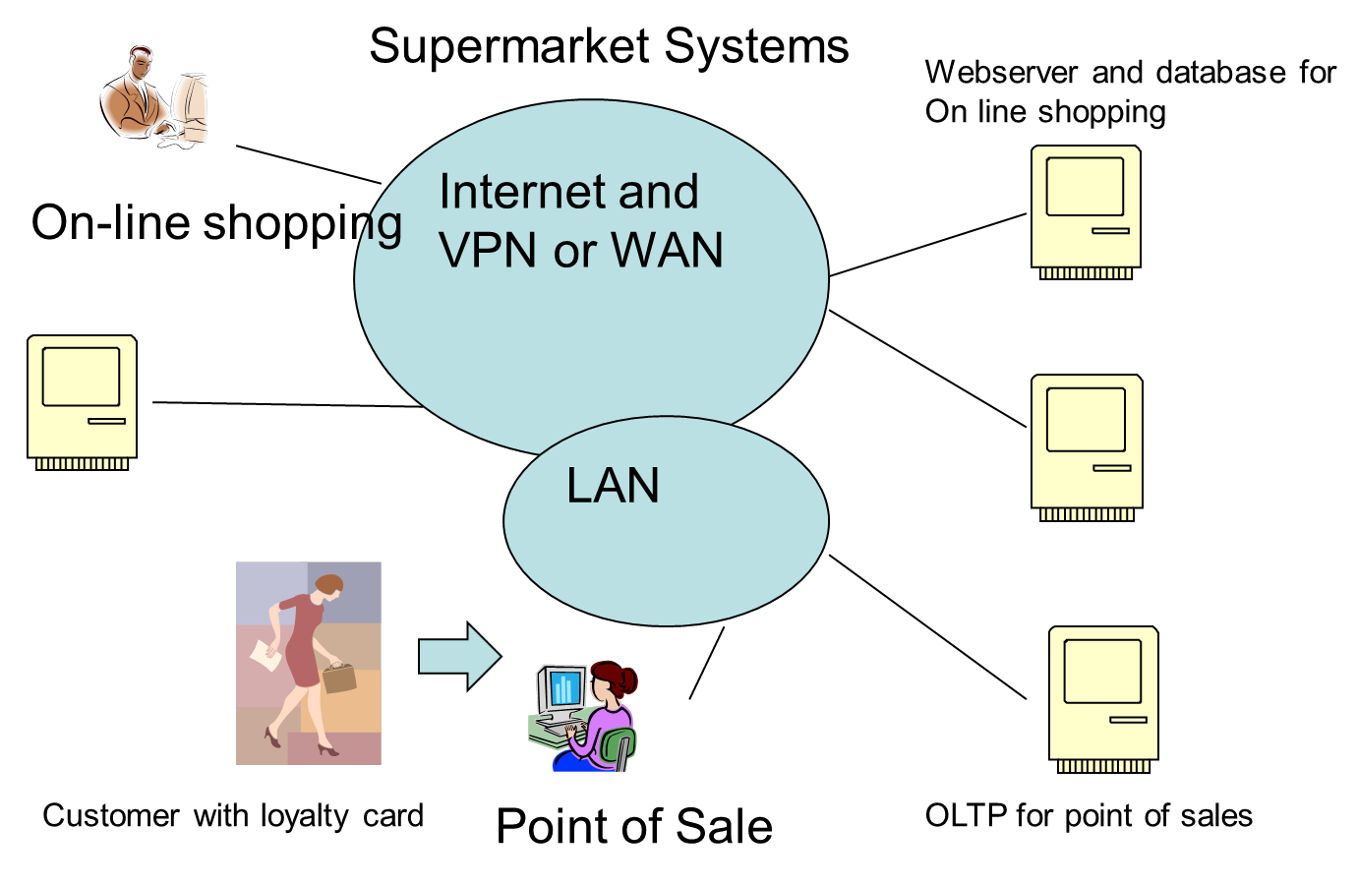
Need for Data Warehouse
Sales Trends
Customer Buying habits
Regional variations
Variations by time
Goods generating
profitt

Slide 33
Customer loyalty data
On-line sales
Fact Table e.g. Sales trends
Star Schema
Central table surrounded
by reference tables
Store sales

Slide 34
Snowflake Schema
Each dimension can have a number
of its own dimensions.
Item Type sales by customer
On-line sales
Customer loyalty
Fact Table e.g Sales Trends
Region information
Store sales
Store sales by Item type

Slide 35
Starflake Schema
Some de-normalisation
On-line sales
Customer loyalty
Fact Table e.g Sales Trends
Region information
Store sales
Store sales by Item type

Slide 36
Midlands
Region
Month
South
North
A M J J A
2009
34
36
34
54
60
Year
2010
38
34
55
58
56
Multi-dimensional data – sales of Ice cream in thousands

Slide 37
Learning Outcomes
By the end of this topic, students will be able to:
  Summarise the key module topics
  Give an outline of the knowledge needed about each topic for assessment purposes
Have we met them?

Slide 38
Topic 12 – Module Overview
Any Questions?
Notes:
NCC Education - End Slide Master

